Slide 1
LIFELINE
Hospital Management System
A Full-Stack CRUD Internship Assignment
Developed by: Anand Kanzariya

Slide 2
Project Overview
Introduction
Lifeline is a digital web platform designed to streamline administrative workflows in medical facilities. The project integrates core CRUD functionalities ensuring medical data can be managed efficiently in a real-world scenario.
The Problem
- Traditional manual paper records lead to delays, errors, and loss of files. - High scheduling conflicts between doctors and patients. - Lack of immediate, centralized data visibility.
The Solution
- Centralized database linking doctors, patients, and scheduling logs. - Responsive React UI ensuring secure, digital CRUD management. - Immediate data updates to reduce diagnostic and scheduling errors.

Slide 3
Key Features
Dashboard Analytics
Offers immediate statistics showing active patient counts, registered practitioners, total bookings, and scheduled slots.
Patient Registry
Allows digital onboarding of patients, recording bio details, contacts, and archiving searchable medical histories.
Doctors Directory
Maintains organized lists of staff, grouping details by specialization department, and contacts for assignment.
Consultation Scheduler
Orchestrates patient bookings with assigned doctors at selective date & times. Features status tracking (Scheduled/Completed/Cancelled).

Slide 4
System Workflow & Architecture
Step 01
Vite Dev Server
Hosts React Single Page Application (Port 5173)
Step 02
Axios API Request
Asynchronous HTTP JSON Payload Transmission
Step 03
Spring Boot Rest
Tomcat API Controller Interception (Port 8080)
Step 04
Hibernate JPA
Object-Relational Mapping & DB query execution
Step 05
PostgreSQL 18
Persistent relational storage on local schema

Slide 5
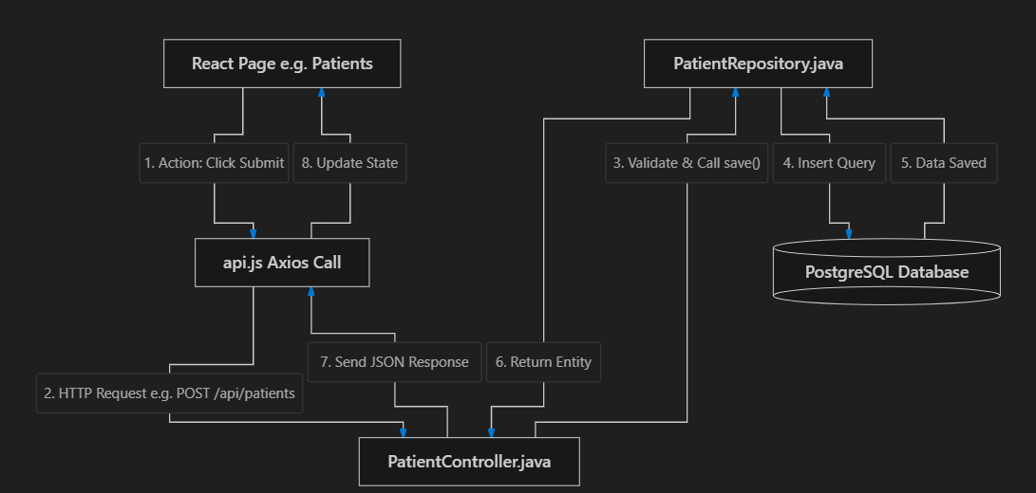
Patients WorkFlow

Slide 6
Technology Stack - Frontend
React 19
Virtual DOM rendering engine with declarative state hooks allowing for modular components.
React Router DOM v7
Client-side routing implementation to create a fluid, zero-page-reload user experience.
Axios Client
Promise-based HTTP library to send JSON data request bodies to the REST endpoint controllers.
Vanilla CSS Variables
Highly customized styles with absolute support for dark/light themes, animations, and transitions.
Vite Bundler
Extremely fast HMR bundler compiling assets quickly, securing optimized bundle outputs.

Slide 7
Technology Stack - Backend & DB
Spring Boot 4.1.0
Main Java framework providing embedded Tomcat routing, Dependency Injection, and REST APIs.
Spring Data JPA
Data layer wrapper simplifying boilerplate Hibernate repository access methods.
Hibernate ORM
Automatically maps Java Entity objects to PostgreSQL relational table columns.
PostgreSQL 18
Saves and retrieves records securely on structured tables with primary/foreign keys.
Project Lombok
Precompiles getter/setter and constructor annotations, cleaning java codebase.

Slide 8
Database Design & Entity Schemas
Patients Table
Table: patients
• id : Long (PK, Serial)
• name : String (NOT NULL)
• age : Integer (NOT NULL)
• gender : String (NOT NULL)
• contact_number : String (NOT NULL)
• email : String
• address : String
• medical_history : Text
Doctors Table
Table: doctors
• id : Long (PK, Serial)
• name : String (NOT NULL)
• specialization : String (NOT NULL)
• contact_number : String (NOT NULL)
• email : String
• department : String
Appointments Table
Table: appointments
• id : Long (PK, Serial)
• patient_id : Long (FK -> patients)
• doctor_id : Long (FK -> doctors)
• appointment_date : Date (NOT NULL)
• appointment_time : Time (NOT NULL)
• status : String (NOT NULL)
• reason : String

Slide 9
REST API Endpoints
Patient Controller
GET /api/patients
Retrieves array list of all patients.
POST /api/patients
Registers and validates a new patient.
PUT /api/patients/{id}
Updates target patient profile info.
DELETE /api/patients/{id}
Removes patient metadata from system.
Appointment Controller
GET /api/appointments
Retrieves array list of all scheduled bookings.
POST /api/appointments
Creates a new appointment (validates constraints).
PUT /api/appointments/{id}
Reschedules or changes booking status.
DELETE /api/appointments/{id}
Cancels and deletes appointment logs.
Doctor Controller
GET /api/doctors
Retrieves the complete list of all registered doctors.
POST /api/doctors
Registers a new doctor in the hospital system.
PUT /api/doctors/{id}
Updates the details of an existing doctor
DELETE /api/doctors/{id}
Removes a doctor record from the hospital system.

Slide 10
Project Achievements & Learnings
✔ Full-Stack Integration
Seamless implementation mapping front-end user actions through REST calls directly updating PostgreSQL structured columns.
✔ Secure TrustStore Solution
Resolved Maven dependency build issues by utilizing custom trust stores ($env:MAVEN_OPTS Windows Root certificates) locally.
✔ Zero-Dependency CSS styling
Designed a responsive client GUI containing modals, search queries, tables, and toggles without external component libraries.
✔ Database integrity & validations
Configured cascade mapping rules and Hibernate DDL updates, ensuring entity relations stay structurally consistent.

Slide 11
THANK YOU
Questions & Answers
Presentation by Anand Kanzariya

